Slide 1
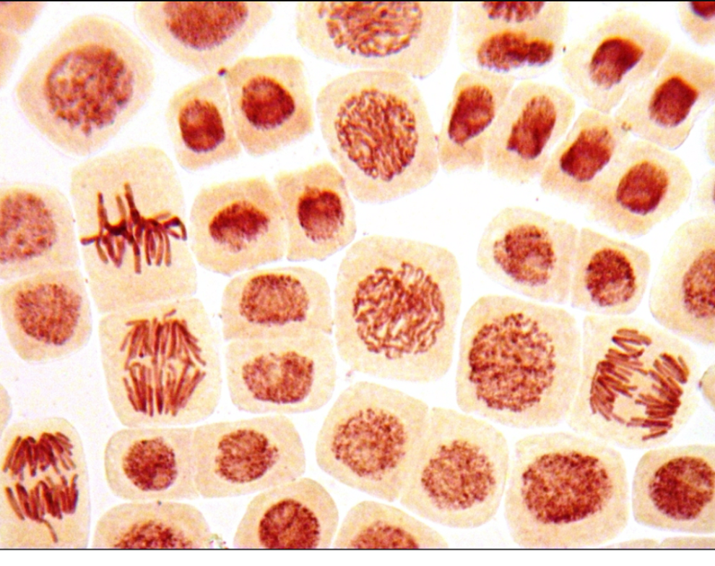
Cell Mitosis
Presented by: David Adams, Bryan Kao

Slide 2
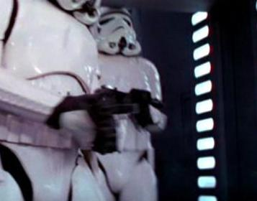
What is Mitosis?
a continuous, 5 step process where a cell creates genetically IDENTICAL COPIES of itself….

Slide 3
What is Mitosis?
In other words, it’s a process during which the nucleus is divided and duplicated

Slide 4
Why is Mitosis significant?
This kind of cell division is a key component of…
Growth in multi-cellular bodies (like humans!)
Cell Replacement (worn out RBC’s, parts of the digestive tract, etc)
Regeneration of body parts (starfish?!)
Asexual Reproduction (vegetables, certain animals, etc.)

Slide 5
Before passing Go…
A cell needs to meet certain criteria by S-Phase before it can proceed…
Centrosomes have been duplicated
Compacting Proteins manufactured
DNA has been duplicated
DNA Scaffolding has been put into place
Cell Volume reaches a certain standard

Slide 6
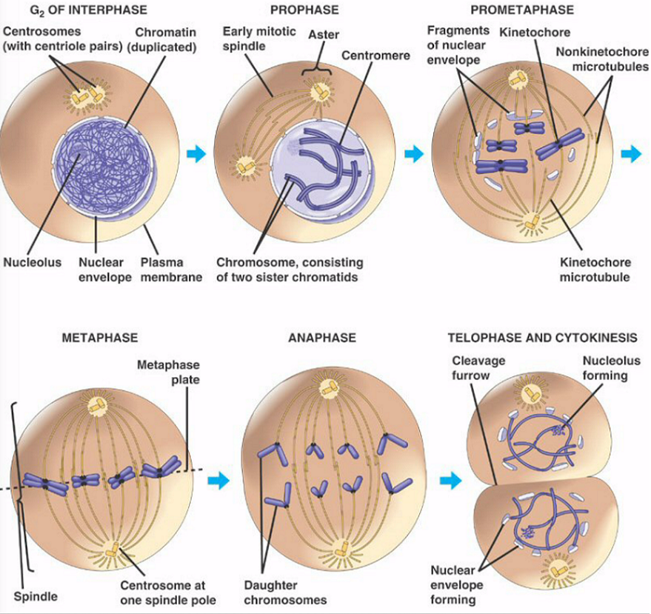
Overview of Steps

Slide 7
Overview of Steps
It is important to note that despite often being listed and occurring at the same time…
There are also many organisms (plants, animals, and fungi alike), in which Cytokinesis and Telophase occur separately.
Thus, strictly speaking, CYTOKINESIS is not considered part of Mitosis, but is a SEPARATE process entirely.

Slide 8
Collect $200, enter Prophase
The GOALS of Prophase are to…
form a Mitotic Spindle
and to prepare Chromosomes for DIVISION

Slide 9
Collect $200, enter Prophase
Microtubules in the Cytoskeleton dissolve.
With the “anchors” of the cell out of the way, the individual components involved can now move as they need
Centrosomes migrate to opposite ends of the cell.
As the centrosomes end up as far away from each other as possible, the locations the centrosomes end up at are referred to as Spindle Poles

Slide 10
Collect $200, enter Prophase
Duplicated DNA interacts with Compacting Proteins in the nucleus to form SISTER CHROMATIDS

Slide 11
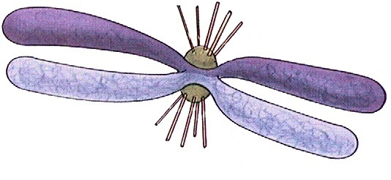
Collect $200, enter Prophase
The DNA Scaffolding is a protein “mold” that pulls the Sister Chromatids together to form a Chromosome

Slide 12
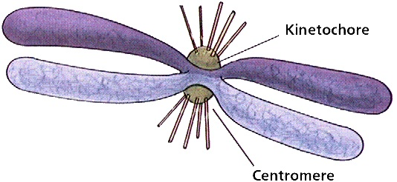
Collect $200, enter Prophase
The chromatids are joined at a CENTROMERE, which has a Kinetochore structure

Slide 13
Collect $200, enter Prophase
Centrosomes and Chromosomes
further develop…

Slide 14
Collect $200, enter Prophase
Centrosomes gain a star-shaped appearance, become known as
+
ASTERS, and…
+
-
+
+
Form POLAR Microtubules, which, when finished, act as a bridge, guiding components towards where they need to go, as well as a structure to push the centrosomes away from each other

Slide 15
Collect $200, enter Prophase
Centrosomes also
+
+
+
+
-
+
+
+
Form ASTRAL Microtubules, which eventually anchor the Aster to the cell membrane

Slide 16
Collect $200, enter Prophase
Centrosomes also
+
+
+
+
+
-
+
+
+
Form Chromosomal Microtubules, which attach onto and participates in dividing the Chromosome

Slide 17
Collect $200, enter Prophase
The Kinetochore is where the centrosome will attach its Chromosomal Microtubules

Slide 18
Prometaphase in the middle
Prometaphase is an intermediate step,
where the final preparations are put into place,
and several processes which begun in Prophase are finalized.

Slide 19
Prometaphase in the middle
The nuclear envelope FRAGMENTS…

Slide 20
Prometaphase in the middle
…Several steps initialized in the Prophase are finalized in the Prometaphase…
Centrosomes reach their final destinations at opposite ends of the cells (Spindle Poles)
Astral Microtubules contact and anchor into the cell’s plasma membrane

Slide 21
Prometaphase in the middle
…And Chromosomal Microtubules attach onto the Kinetochore
Towing the Chromosomes towards the “middle line” of the cell, called a METAPHASE PLATE.

Slide 22
Metaphase, get set…!
Chromosomes finish lining up at the Metaphase Plate.
Chromosomal Microtubules start pulling at the individual Chromatids
Only growing tension No visible separation yet

Slide 23
Anaphase, go!
The shortest phase, Anaphase has TWO DISTINCT MOVEMENTS in regards to Mitosis, conveniently named ANAPHASE A and ANAPHASE B.
This does not denote a difference in timing, but rather a difference in what is being moved.

Slide 24
Anaphase, go!
The shortest phase, Anaphase has TWO DISTINCT MOVEMENTS in regards to Mitosis, conveniently named ANAPHASE A and ANAPHASE B.
ANAPHASE A: Chromosomes are pulled apart, each chromatid towards the relatively and respectively closer centrosome
ANAPHASE B: Centrosomes increase the distance between each other, effectively elongating the cell and assisting in putting more distance between the chromatids.

Slide 25
Anaphase, go!
Both types of Anaphase share certain characteristics:
Movement is caused by manipulation of the microtubular subunit TUBULIN
This manipulation is based on a special “motor” protein
This “motor” protein combines the ability to disassemble the tubulin subunits, as well as to “walk” towards a pole on the microtubule.

Slide 26
Anaphase, go!
ANAPHASE A: Chromosomes are pulled apart, each chromatid towards the relatively and respectively closer centrosome
+
+
-
+
+
The “motor” proteins disassemble tubulin from both the positive and negative ends, while simultaneously contracting.

Slide 27
Anaphase, go!
ANAPHASE B: Centrosomes increase the distance between each other, effectively elongating the cell and assisting in putting more distance between the chromatids.
Anaphase B is a combination of two different motions…
Polar Microtubules growing longer, and pushing
Astral Microtubules growing shorter, and pulling

Slide 28
Anaphase, go!
ANAPHASE B: Centrosomes increase the distance between each other, effectively elongating the cell and assisting in putting more distance between the chromatids.
Polar Microtubules growing longer, and pushing
+
+
+
+
-
+
+
-
+
+
+
The “motor” proteins attach tubulin onto the positive ends, while extending and pushing the centrosomes further away from each other.

Slide 29
Anaphase, go!
ANAPHASE B: Centrosomes increase the distance between each other, effectively elongating the cell and assisting in putting more distance between the chromatids.
Astral Microtubules grow shorter, and pull at the aster
+
+
-
+
The “motor” proteins disassemble tubulin from the positive ends, while contracting and pulling the centrosome closer to the cell membrane.

Slide 30
Telophase…are we there yet?
Polar Microtubules continue elongating the cell further
The nuclear envelope, using pieces fragmented during Prometaphase, reforms around the sister chromatid.
The individual chromatids begin unraveling.

Slide 31
The end is in sight! Cytokinesis!
Cytokinesis usually begins sometime between late Anaphase and early Telophase.
The processes for Plant and Animal Cytokinesis differ slightly…
but we are only interested in the Animal process for our purposes.

Slide 32
The end is in sight! Cytokinesis!
Cytokinesis is the process of dividing up a cell’s cytoplasm.
As the Mitotic Spindles begin break down, a Contractile Ring is assembled in the cell cortex, centered around the Metaphase Plate

Slide 33
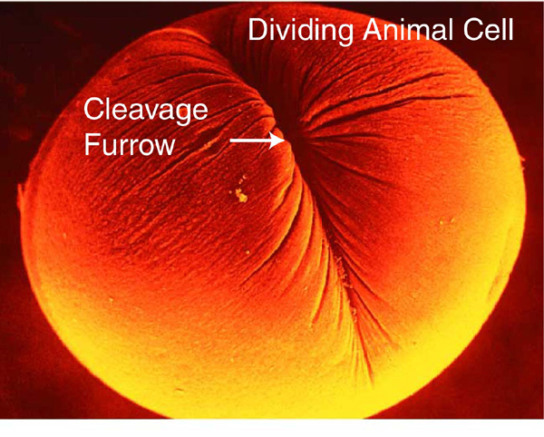
The end is in sight! Cytokinesis!
Hydrolysis causes this ring to perpetually contract (ingression), causing a cleavage furrow.
Eventually, the same ring causes a physical cleaving of the cell into separate halves (abscission).

Slide 34
Citations
Cooper, Geoffrey. Microtubule Motors and Movements. Accessed June 1, 2015.
Gelot, Camille, Indiana Magdalou, and Bernard Lopez. "Replication Stress in Mammalian Cells and Its Consequences for Mitosis." Genes, 2015, 267-98.
Marieb, Elaine Nicpon, and Katja Hoehn. Human Anatomy & Physiology. 9th ed. Boston: Pearson, 2013. 100-101.

